Slide 1



Calla & Ivy Sales’ Campaign
Report
Los Angeles, CA
April, 2021
Image plac eholder

Slide 2
Goal
Increased sales by 10% by the end of Quarter One (Q1)
Campaign Objective:
Conversion/Purchase
KPI:
Number of Purchase
(Source of verification: Facebook Pixel )

Slide 3
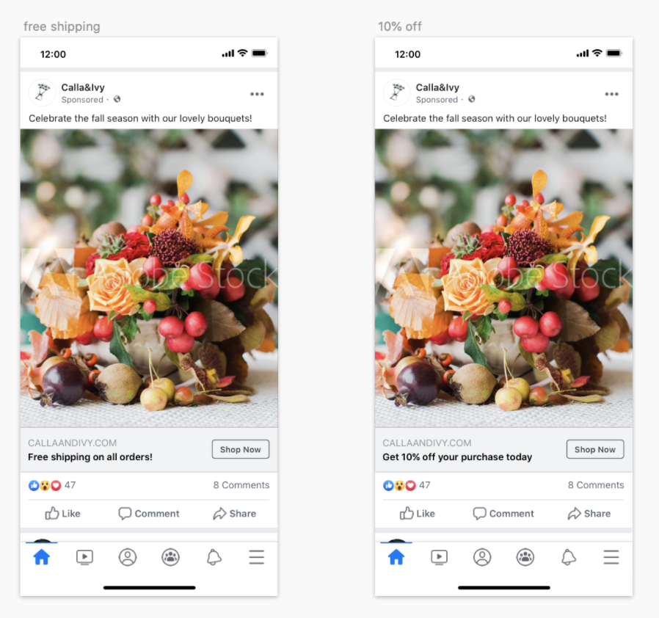
Creative
Assets
Image placeholder

Slide 4
Campaign
Settings
Objective:
Website Traffic
Audience:
Age: 24 - 55
Gender : Females
Location: Northern Holland
Placement:
Facebook, Instagram & Audience network
Duration:
40 days (Nov 6 - Dec 15)
Budget:
$2,000

Slide 5
Results
Campaign Result
40,350 Link Click
$0.07/link click
2% of Link Click Convert=> 807 purchase
Campaign Cost
$2,000 (40 days * $50)
ROAS: 16.14
Revenue
$40 for each purchase = $32,280
Total Investment
Advertising: $2,000
Cost: $15,105 ($15 per Purchase)
Total Investment: $14,105
ROI: 1.29

Slide 6

Results
Calla & Ivy Fall Promo Free shipping with lowest cost per result at $0.08
95% Confidence
Image placeholder
Image placeholder

Slide 7
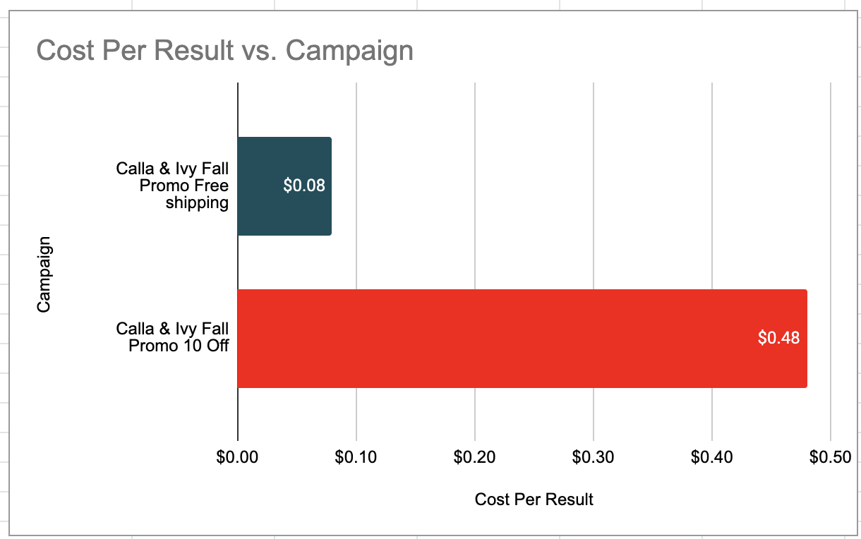
Results
(Insight)
Calla & Ivy Fall Promo Free shipping with lowest cost per result at $0.08
Image placeholder
Image placeholder

Slide 8
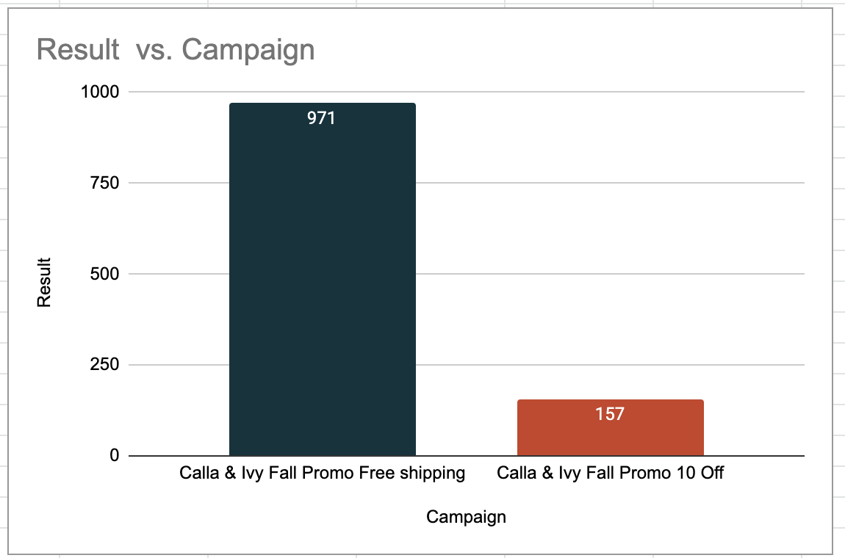
Results
(Insight)
Calla & Ivy Fall Promo Free shipping with more result of 971
Image placeholder
Image placeholder

Slide 9
Conclusion & Next Steps
Include Males as well in the future
Expand the platforms to further optimize the result
Continue with an ad Promo having Free shipping offer for the similar campaign.
keep testing(A/B) to optimize creative
Keep optimizing to reduce conversion cost

Slide 10
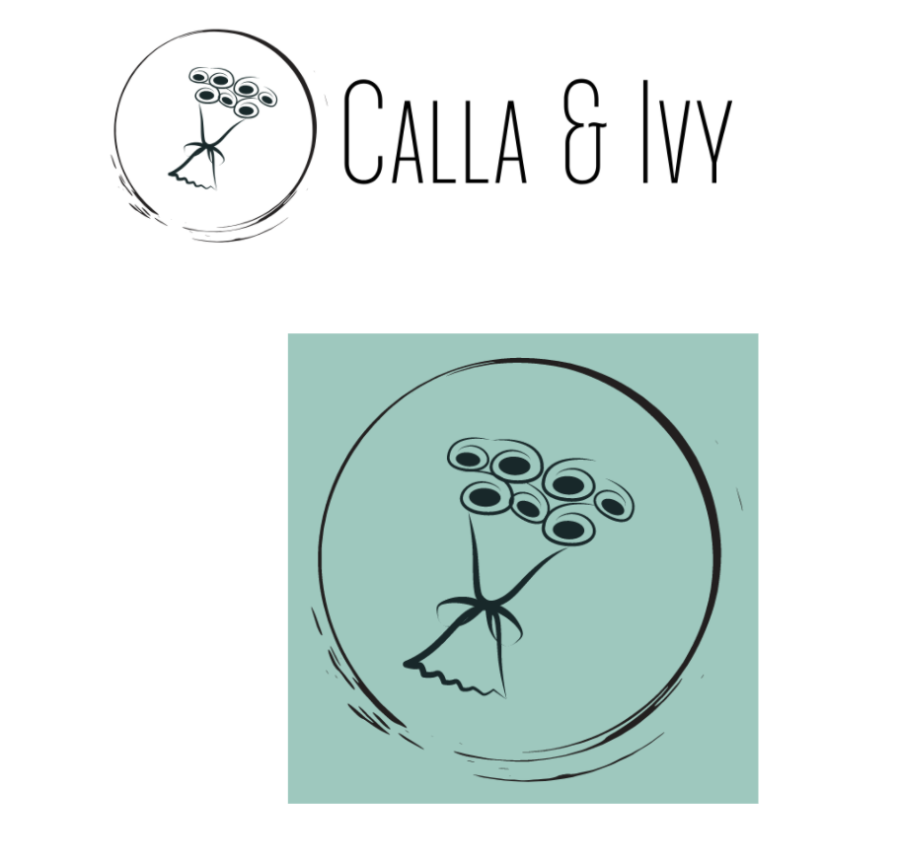

Thank
You!
Any Question?
Image placeholder

